Slide 1

Smart waste
Omkar sawant
Sarang shinde

Slide 2
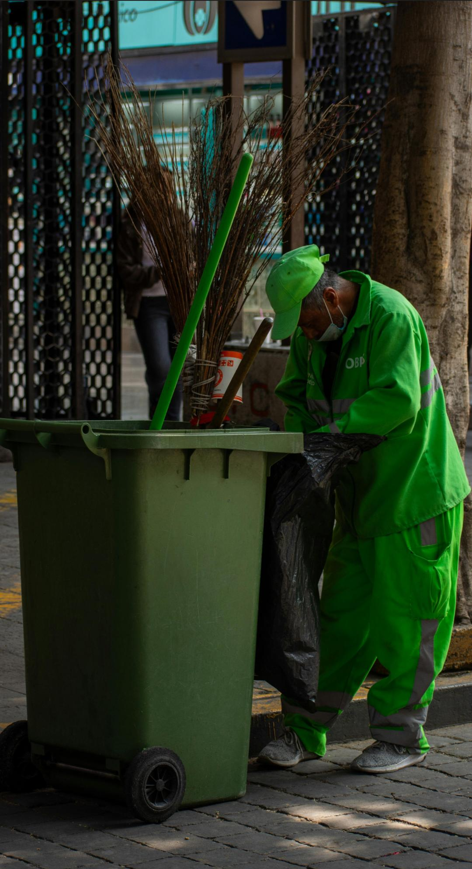
Introduction
1.The smart waste is project created out of concern about environmental issues arising due to lack of proper waste management.
2.And smart waste is small yet ambitious solution that we try to implement into society, to help manage waste and keep our life healthy.

Slide 3

The problem
India ranks first globally as the largest emitter of plastic pollution , realising approximately 9.3 million tonnes of plastics waste annually.
Today these in various health problems like asthma , cancer, various digestive problems, Chorela,typhoid,hepatic B/C etc. are either cause due to waste or are related to the waste pollution directly or indirectly.
Poor waste management lead to poor quality of lifestyles.
Physical waste not only pollute things by land contamination, but is directly related to increase in water and air pollution .
And the all these problem arise when we do not mange waste property ,and some responsibilities for that must be due to lack of incompatibility of governing body and lazy and non- discipline citizens of country.
The mismatch of timing of garbage collecting truck lead to increase in waste piles in environment, so the citizens not knowing when to dispose garbage must be avoid.

Slide 4
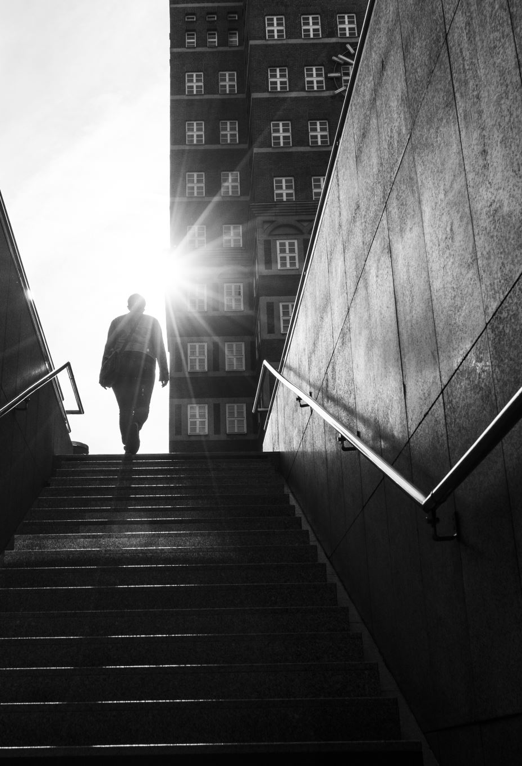
Intentions
So our intention through this project is to help society manage waste , ultimately improving there standards of living, by providing convenient options to handle waste .
In Today’s era of technology we should try to find solutions of these traditional problems with new and technological solutions that’s why we invented smart waste .
To reduce waste piles so the adverse effects of waste on environment to reduce soil pollution,water pollution,air pollution, improve standard.

Slide 5

Invention
The smart waste is made in digital platforms , we have invented this project to bring convenience in garbage collecting system with providing detail time schedule with delay and tracking of garbage collecting vehicle ,with exact locations of these vehicles.
It also provide cleaning solution to generals citizens as we tend to create platform that can be intermediate between workers and citizens, which will create employment and give citizens solid option to manage waste .(It can include government institute, public places, hotels, hospitals,or even private sector institutions or private household.)

Slide 6
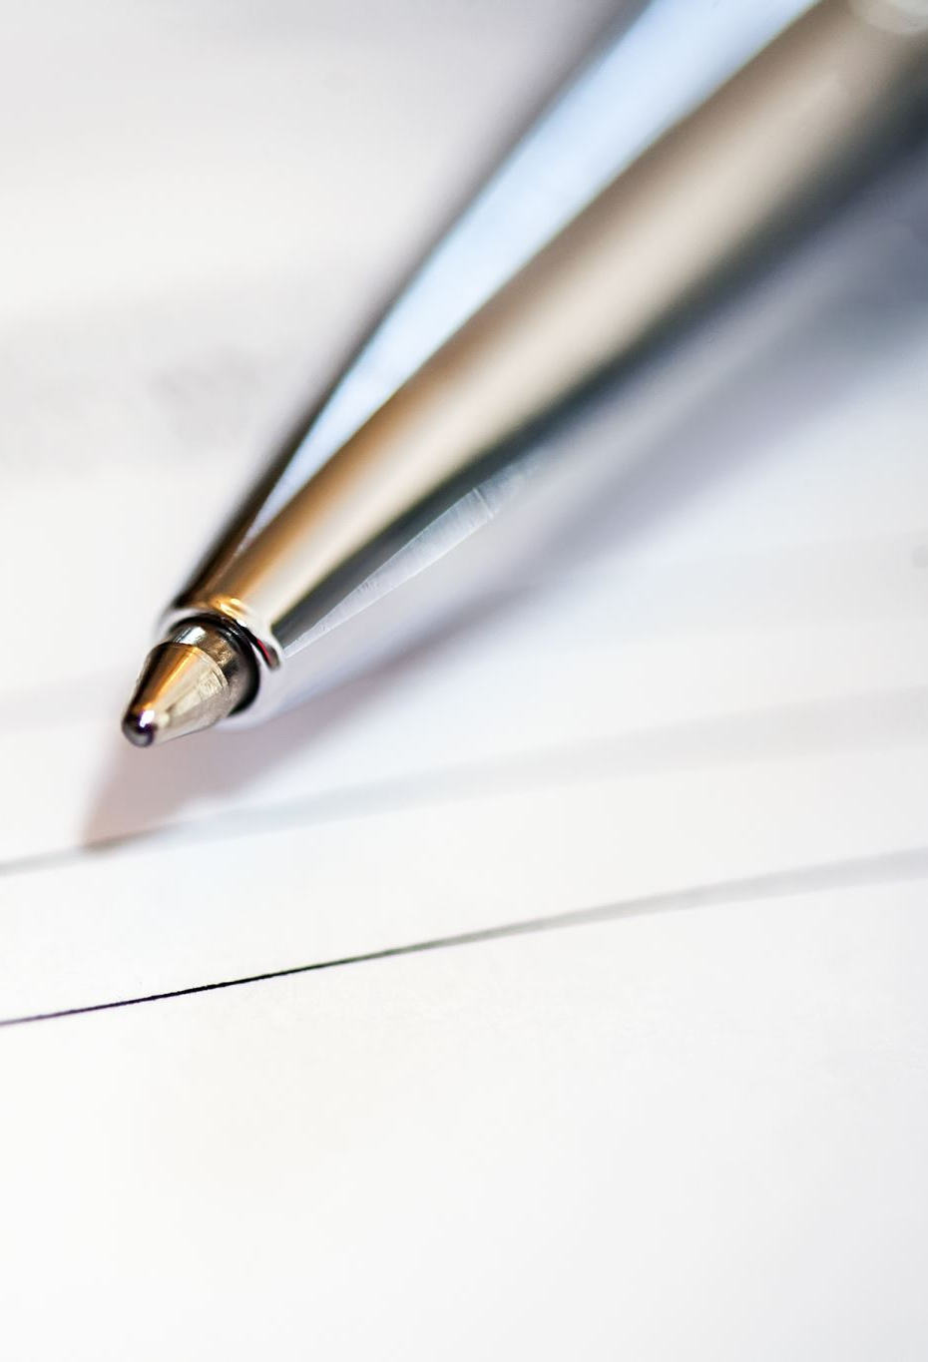
Methodology
The methods use to create this project are:-
1. php(Hypertext preprocessor ).
HTML (Hypertext Markup Language).
CSS (Cascading Style Sheets).
VS-code is platform where all this language got integrated into code .
AI engines like chat gpt-5, Gemini, Google search have been handy to create this project.

Slide 7
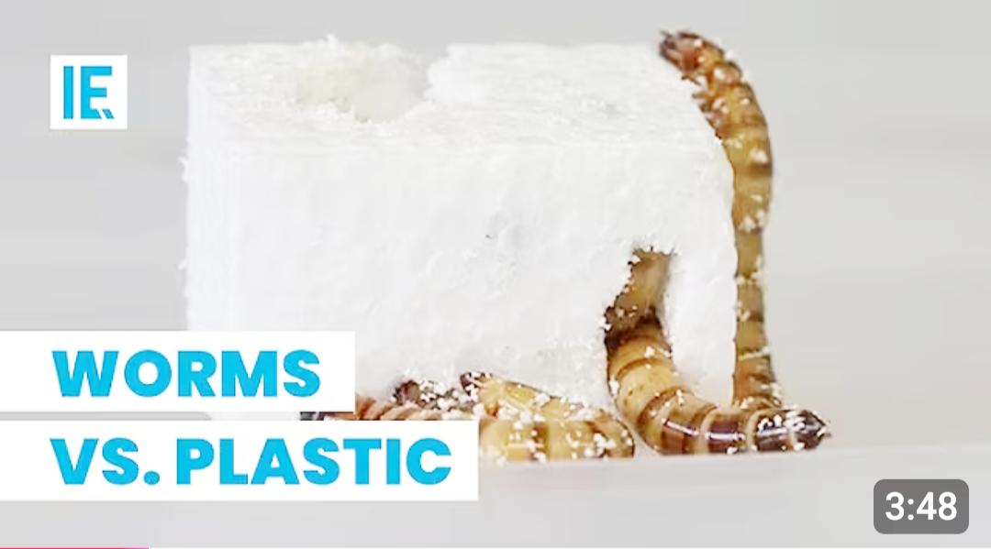
Interesting fact
The breakthrough lies in the mealworm's astounding ability to digest plastic—a feat once deemed impossible.
This discovery offers a glimmer of hope in the battle against plastic pollution, potentially providing a key to mitigating a worldwide environmental disaster.

Slide 8
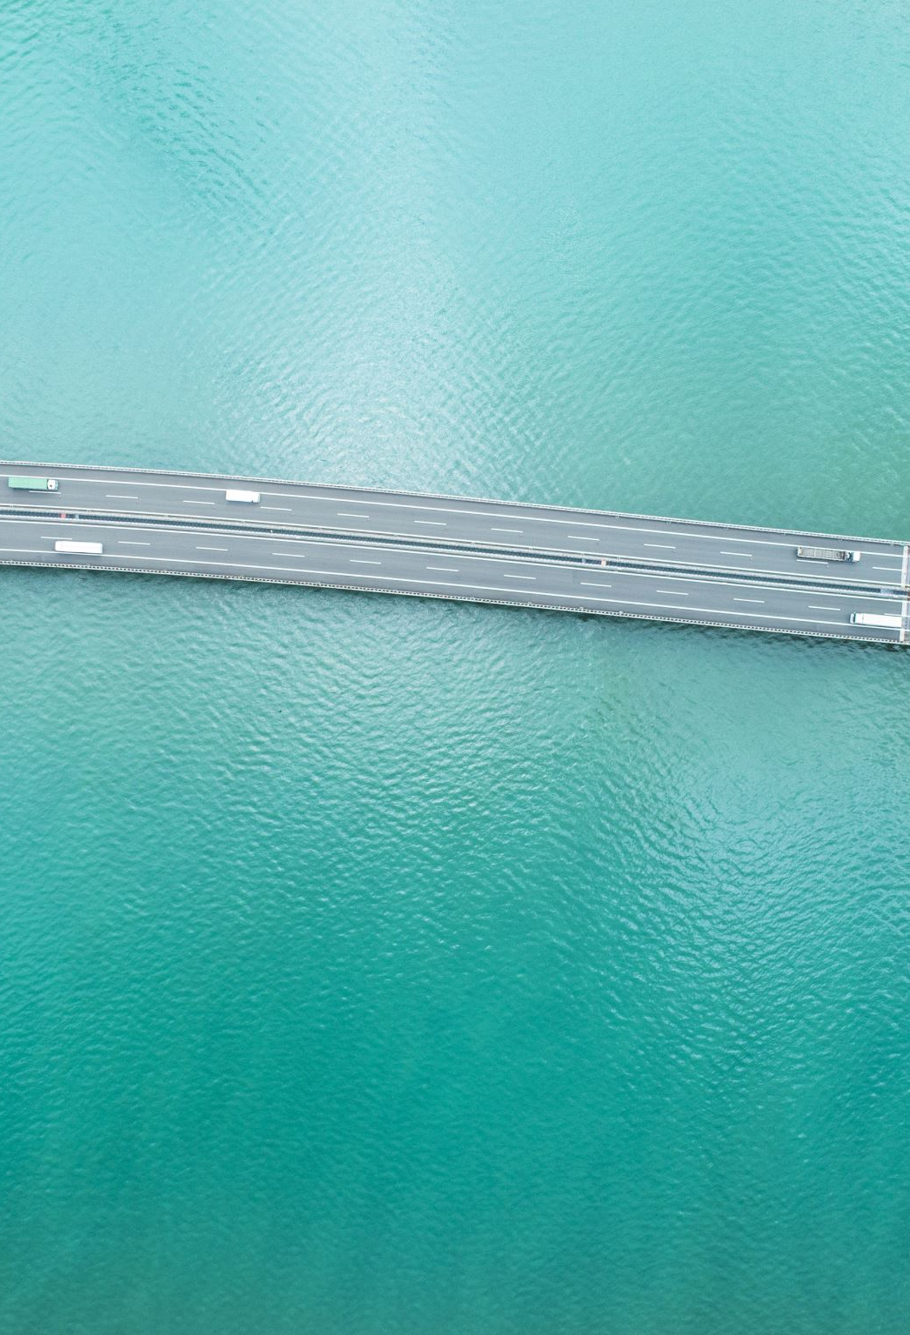
Thank you

